Slide 1
DEPARTMENT OF INFORMATION SCIENCE & ENGINEERING
MINI PROJECT II (PROJ22IS66)
CivicFlow — AI Civic Issue Triage Assistant to enhance the system performance
Presented by:
Under the guidance of:
Bhoomika 1DS23IS031
Chandra Shekar 1DS23IS035
Chetan S 1DS23IS037
Dikshith M 1DS23IS044
Dr. Vaidehi M
Professor
Dept. of ISE, DSCE, Bangalore

Slide 2
CONTENTS
Abstract
Introduction
Literature survey
Problem analysis and design
5. System design & Methodology
Implementation
Testing and validation
Results and discussion
Conclusion & Future work
References

Slide 3
Abstract
CivicFlow is an AI-powered, multimodal assistant that automates the triage of civic complaints received through text, voice, and images.
It uses Whisper-based speech recognition, OCR and image captioning, and LLM-driven structured output to classify and route issues to the correct municipal departments.
A Retrieval-Augmented Generation (RAG) layer grounds responses in municipal guidelines, ensuring factual accuracy and traceability.
By streamlining 311-style workflows and enabling real-time tracking, CivicFlow enhances efficiency, transparency, and accountability in public service delivery.

Slide 4
Introduction
Every day, city administrations receive thousands of complaints from citizens about damaged roads, water leaks, garbage accumulation, and power failures. These complaints arrive through multiple channels — text messages, emails, WhatsApp voice notes, social media posts, and images — often in different regional languages, making the data unstructured and difficult to process manually.
The current manual triage process is slow, inconsistent, and error-prone. On average, it takes 2 to 3 days to process a single complaint, nearly 30% of complaints are misrouted to the wrong department, and 40% of urgent issues breach their SLA deadlines. This leads to delayed resolutions and reduced trust in civic institutions.
AI Civic Issue Triage Assistant — is proposed as a solution to this problem. It is an intelligent, multimodal system that automatically ingests complaints from any channel, understands the content using Large Language Models and NLP, classifies the issue, and routes it to the correct municipal department in real time

Slide 5
Literature survey
Year | Authors / Source | Findings
2025 | Adebayo Da’Costa, Jennifer Teke, Joseph E. Origbo, Ayokunle Osonuga, Eghosasere Egbon, David B. Olawade | AI-driven triage systems improve efficiency and accuracy in emergency departments, though challenges remain in implementation and ethical oversight.
2024 | Amir Tahernejad, Amir Sahebi, Ali S. S. Abadi, Mohammad Safari | Systematic review highlighting AI’s applications in triage for disasters and emergencies; emphasizes data integration, accuracy, and ethical frameworks.
2025 | Alexandra Costoiu | Discusses AI literacy as a fundamental civic right and educational necessity for second-language learners in a globalized society.
2025 | Samuel G. Gabriel | Explores AI-driven administrative systems and their role in reshaping citizen–government interactions, focusing on transparency and efficiency.
2025 | Alexandra Costoiu (Reading Matrix Journal) | Reiterates the civic importance of AI literacy; suggests educational policies to integrate AI awareness in language and civic education.

Slide 6
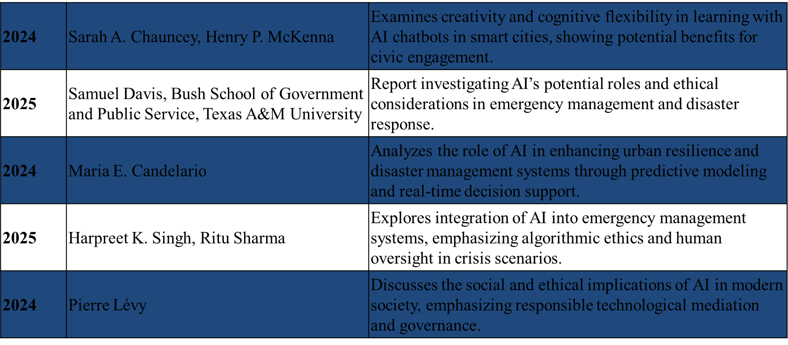
Literature survey

Slide 7
Problem analysis and design
Governments receive thousands of complaints monthly (roads, water, waste, noise).
Inputs come from text, audio, images → unstructured & multilingual.
Manual triage causes 2–3 days delays & 30 % mis-routing.
There is a need for an automated, accurate, and scalable system to classify & route issues in real time.

Slide 8
Problem analysis and design
Automate complaint triage and department routing using AI
Support multimodal inputs — text, audio, and image
Generate structured JSON tickets for easy database insertion
Provide real-time analytics dashboard for city officials
Support continuous feedback loop for model improvement

Slide 9
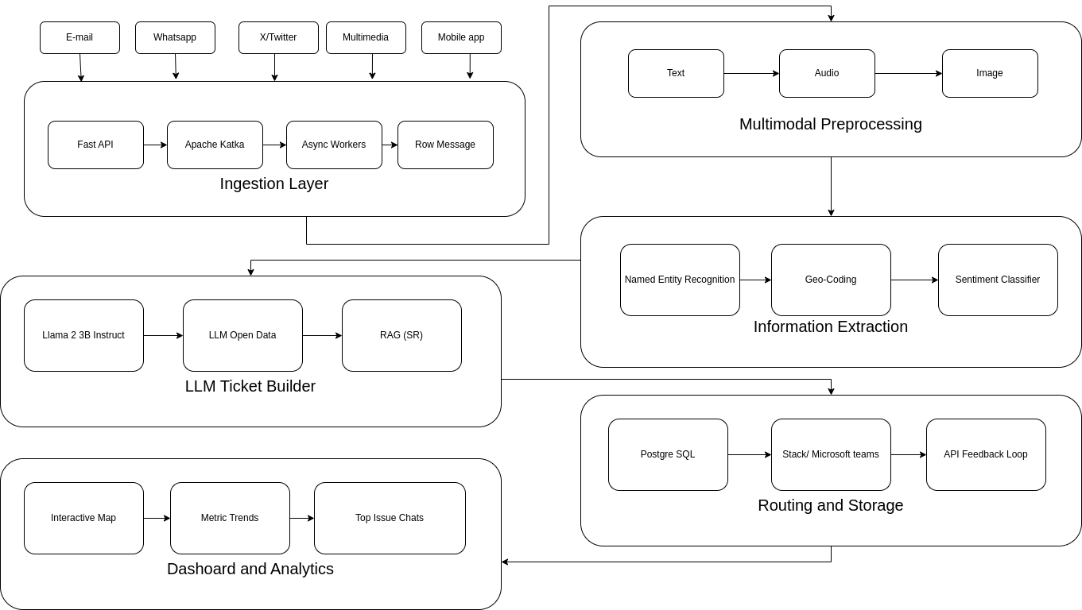
System design & Methodology

Slide 10
Implementation
The AI Civic Triage Assistant was implemented as a full-stack web application using Next.js for both frontend and backend development. The user interface was designed using React and styled with Tailwind CSS to create a responsive and user-friendly layout. The system allows users to submit civic complaints through an online form, which is validated before being sent to the backend via API routes. The backend processes the complaint and sends the text to an AI model for classification and triage. The AI analyzes the complaint and categorizes it into appropriate departments such as water supply, road maintenance, garbage management, or electricity services. All complaint data, along with the AI-generated category and status, is securely stored.The system ensures proper data handling, structured API communication, and scalable architecture, enabling efficient complaint management and intelligent civic issue routing.

Slide 11
Testing and validation
The AI Civic Triage Assistant was implemented as a full-stack web application using Next.js for both
TC# | Test Case Description | Input | Expected Output | Status
TC-01 | Text complaint classification - road damage | Text: "Large pothole on MG Road near Brigade junction" | Dept: BBMP_Roads, Urgency: Medium, Confidence > 0.85 | PASS
TC-02 | Audio complaint transcription and routing | WAV audio: "Water pipe burst in Indiranagar 5th cross" | Transcription via Whisper, Dept: BWSSB, Urgency: High | PASS
TC-03 | Image complaint captioning and classification | JPG: Overflowing garbage bin image | Caption generated, Dept: BBMP_Solid_Waste, Urgency: Medium | PASS
TC-04 | Duplicate complaint detection | Two text complaints about same pothole (cosine sim > 0.85) | Second complaint flagged as duplicate, linked to original ticket | PASS

Slide 12
Results and discussion
Metric | Before CivicFlow | After CivicFlow
Triage Time | 2–3 days | < 3 seconds
Misrouting Rate | ~30% | < 15%
SLA Breaches | 40% | Real-time monitored
Routing Accuracy | Manual, error-prone | ≥ 85%
RAG integration ensures tickets are aligned with the latest municipal policies and past case resolutions
Multimodal fusion significantly increases complaint coverage compared to text-only systems
Continuous feedback loop allows the model to self-improve from officer corrections nightly
Architecture proved scalable and replicable across different municipalities and institutions
Multilingual support removes language barriers and makes the system inclusive for all citizens

Slide 13
Conclusion & Future work
Conclusion
CivicFlow successfully demonstrates how LLMs, NLP, and Multimodal AI can transform unstructured citizen complaints into structured, actionable government tickets
The system eliminates manual bottlenecks, reduces triage time by over 90%, and improves routing accuracy beyond 85%
Built with a scalable, modular architecture deployable across any urban governance setup
Directly addresses SDG 9, 11, and 16 by making civic infrastructure smarter and governance more accountable
Future Work
Mobile App — Citizen-facing app for geo-tagged complaint submission and real-time status tracking
Regional Language Support — Fine-tune models for Kannada, Tamil, Telugu, and Hindi dialects
Predictive Analytics — Forecast complaint hotspots before issues escalate using historical patterns

Slide 14
References
[1] A. Da’Costa, J. Teke, J. E. Origbo, A. Osonuga, E. Egbon, and D. B. Olawade, “AI-driven triage in emergency departments: A review of benefits, challenges, and future directions,” Int. J. Med. Inform., vol. 197, p. 105838, May 2025, doi: 10.1016/j.ijmedinf.2025.105838.
[2] A. Tahernejad, A. Sahebi, A. S. S. Abadi, and M. Safari, “Application of artificial intelligence in triage in emergencies and disasters: A systematic review,” BMC Public Health, vol. 24, no. 1, p. 3203, 2024, doi: 10.1186/s12889-024-20447-3.
[3] A. Costoiu, “AI literacy as a civic necessity and a human right: Implications for second language learners in a globalized world,” Reading Matrix: Int. Online J., vol. 25, no. 1, pp. 43–50, 2025.

Slide 15
References
[4] S. G. Gabriel, “AI-driven administrative systems and the future of citizen-government interactions.” [Online]. Available: https://www.researchgate.net/profile/Samuel-Gabriel-6/publication/AI-Driven-Administrative-Systems-and-the-Future-of-Citizen-Government-Interactions.pdf . [Accessed: Nov. 5, 2025].
[5] A. Costoiu, “AI literacy as a civic necessity and a human right: Implications for second language learners in a globalized world,” Reading Matrix: Int. Online J., vol. 25, no. 1, 2025. [Online]. Available: https://www.readingmatrix.com/files/34-pu6skrn7.pdf. [Accessed: Nov. 5, 2025].
[6] S. A. Chauncey and H. P. McKenna, “Creativity and innovation in civic spaces supported by cognitive flexibility when learning with AI chatbots in smart cities,” Urban Sci., vol. 8, no. 1, p. 16, 2024, doi: 10.3390/urbansci8010016.

Slide 16
References
[7] S. Davis, “Inquiry into AI as related to emergency management,” Bush School of Government and Public Service, Texas A&M University, College Station, TX, USA, Final Report, 2025. [Online]. Available: https://bush.tamu.edu/wp-content/uploads/2025/06/Davis_Final-Report_Inquiry-into-AI-as-related-to-Emerg-Mgmt_24-25.pdf. [Accessed: Nov. 5, 2025].
[8] M. E. Candelario, “Artificial intelligence for urban resilience and disaster risk management,” Urban Sci., vol. 8, no. 1, p. 16, 2024, doi: 10.3390/urbansci8010016.
[9] H. K. Singh and R. Sharma, “AI in emergency management systems: Integration and ethical implications,” Urban Sci., vol. 9, no. 7, p. 249, 2025, doi: 10.3390/urbansci9070249.
[10] P. Lévy, “Artificial intelligence, society, and the ethics of technological mediation,” HAL Archives Ouvertes, 2024. [Online]. Available: https://hal.science/hal-05140138/

Slide 17
THANK YOU

